Slide 1
INNOVATION & INCUBATION CENTRE OF EXCELLENCE
TEAM:- EVA
IDEA:- SUSTAINABLE ENERGY THROUGH ROLLING SPEED BREAKERS
FROM - RAJASTHAN INSTITUTE OF ENGINNERING AND TECHNOLOGY

Slide 2
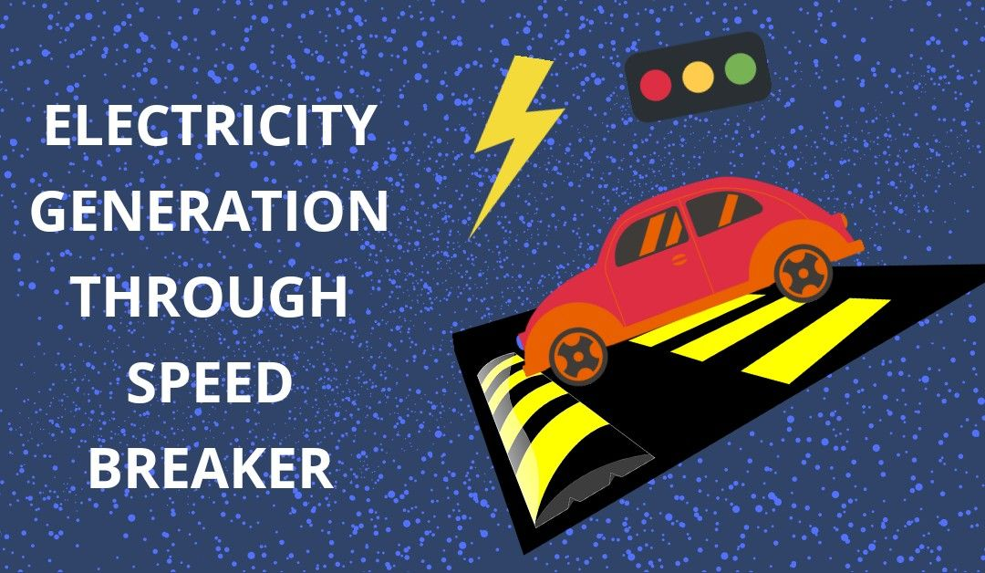
Power generation from speed breakers
TEAM MENTOR(GUIDANCE BY):-AKASH SIR
Team leader : - Khushi Choudhary
OTHER MEMBERS :-
Kamlendra singh naruka
Harshit yadav
Akshay yadav

Slide 3
INTRODUCTION
Speed breaker is used for the break the speed of vehicle but in this project we use this in another way. In this traditional speed breaker is replaced by the roller mechanism.The concept of the rotating speed breaker is nothing but the one small step to reduce the use of conventional source of energy. In this we use roller which is connected to the gears through bearing using shaft. The bearing is used for increase speed and shaft connected to roller used for balance. The couple gears are used. One gear is connected to the shaft and another small gear is connected to the shaft of generator. Electricity is produced as speed breaker is rotate through gear.

Slide 4
EQUIPMENT REQUIRED
A. GEARS This is positive power transmission device with definite velocity ratio. It is preferred for adjusting some linear misalignment. It should have high wear and tear, shockabsorbing capacity
B. Bearing This is a device which is used for the increasing the speed. The Shaft is placed in this device for rolling motion. They reduce the friction and transmit the motion effectively.
C. Motor It is a device, which converts mechanical energy into electrical energy. The generator uses rotating coils of wire and magnetic fields to convert mechanical rotation into a pulsing direct electric current through “Faraday’s law of electromagnetic induction”.
D. Roller (speed breaker) It is the material which is used for the speed breaker. When the tires of vehicle are impact or pass over the roller then it will rotate and produce energy. The material used for the speed breaker as roller is MS
E. Shaft It is the material which is used to connect the roller on this shaft and to rotate the roller(speed breaker).This material is made of steel bar or MS bar. When wheel of vehicle is impact on the speed breaker the shaft connected to this roller is also rotate

Slide 5
WORKING PRINCIPLE
The bearing is provided in order to permit the relative motion between the shafts. In this way vertical motion is to be converted intorotational motion. The one end of the shaft will be fixed with the help bearing. The working of this speed breaker arrangement for producing electricity is very simple. The ball bearings are connected in one side of roller in this project. At one side ball bearing is used to make the linear and smooth rotation of roller. At the second side synchronous AC motor has been connected through mechanical coupling. As the roller rotates because of vehicle motor also starts to rotate due to which electricity is being produced. . The speed breaker on a busy road will be lifted to some height from one side and fixed to the road from other side. There are a large number of automobiles running on the road. These automobiles go over a number of speed breakers present on the road. The vehicle is having a variety of weight like trucks, buses, cars, and two wheelers therefore whenever they are passing over a speed breaker a lot of energy is wasted. So when the vehicle will come on the speed breaker, electricity produced by motor which acts as a generator because it get rotated linearly with the speed breaker due to coupling of speed breaker with motor shaft.
This D.C. voltage is stored to the lead 12-volt battery. This arrangement is fitted in highways; the complete arrangement is kept inside the floor level except the speed brake arrangement. Here we are making speed breaker, when a vehicle crosses the speed breaker the speed breaker will rotate on the basis of weight and the speed of the vehicle. That output of stepper motor voltage is given to the application which being implemented such as street light and traffic light. The produced voltage can also be given to the battery to store the electricity. Through battery we give supply to the port of microcontroller through which traffic light operates. Then the output of the battery is used to lighten the street lamps on the road. Now during daytime we dont need electricity for lightening the street lamps so we are using a control switch which is manually operated .The control switch is connected by wire to the output of the battery. The control switch has ON/OFF mechanism which allows the current to flow when needed.

Slide 6
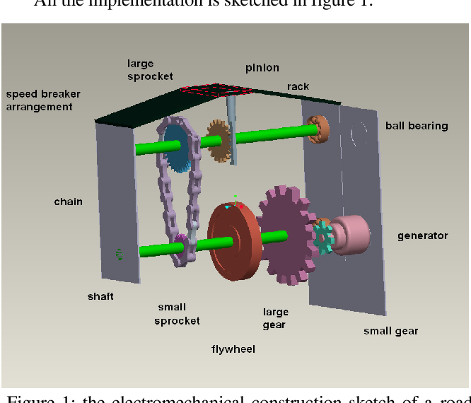
Sketch of roller

Slide 7
ADVANTAGES
Generation of electricity from this equipment having low cost and it will conserve the conventional sources of electricity. • Electricity produced from this method is not depending on the other factor in all the year.
Because of its place of installation maintenance is easy. • As there is no any fuel is used it is pollution free • There is no any effect on the traffic.
Power is generated from the equipment automatically so no any manpower required.
It is non-conventional source of energy

Slide 8
APPLICATIONS
This project is helpful in hilly as well as in remote area where light is not reached.
The electricity produced from this technique is used for street lightning, for signals, and for the lightning for the check post
This technique of electricity production is practically applicable at the place of high density traffic region.

Slide 9
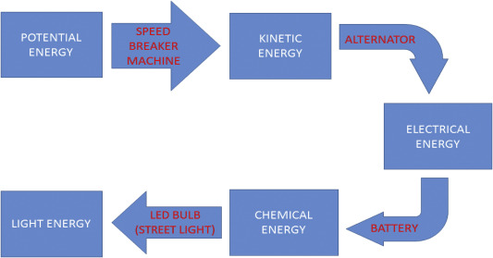
FLOW DIAGRAM

Slide 10
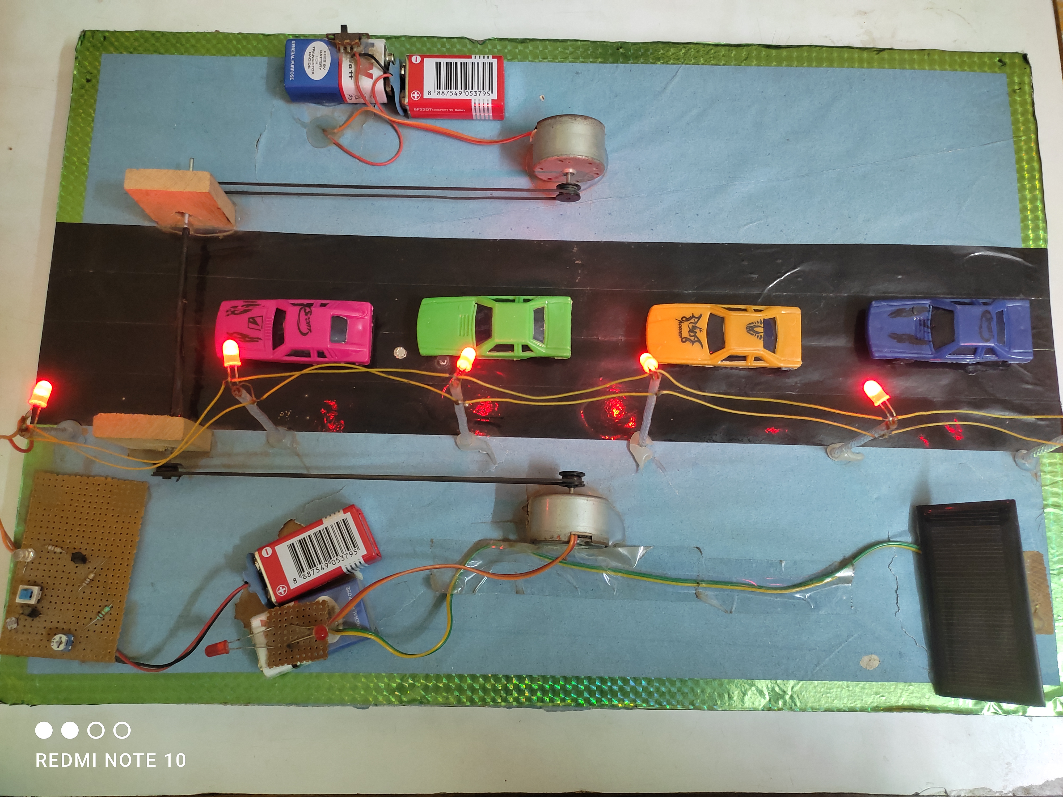

Slide 11
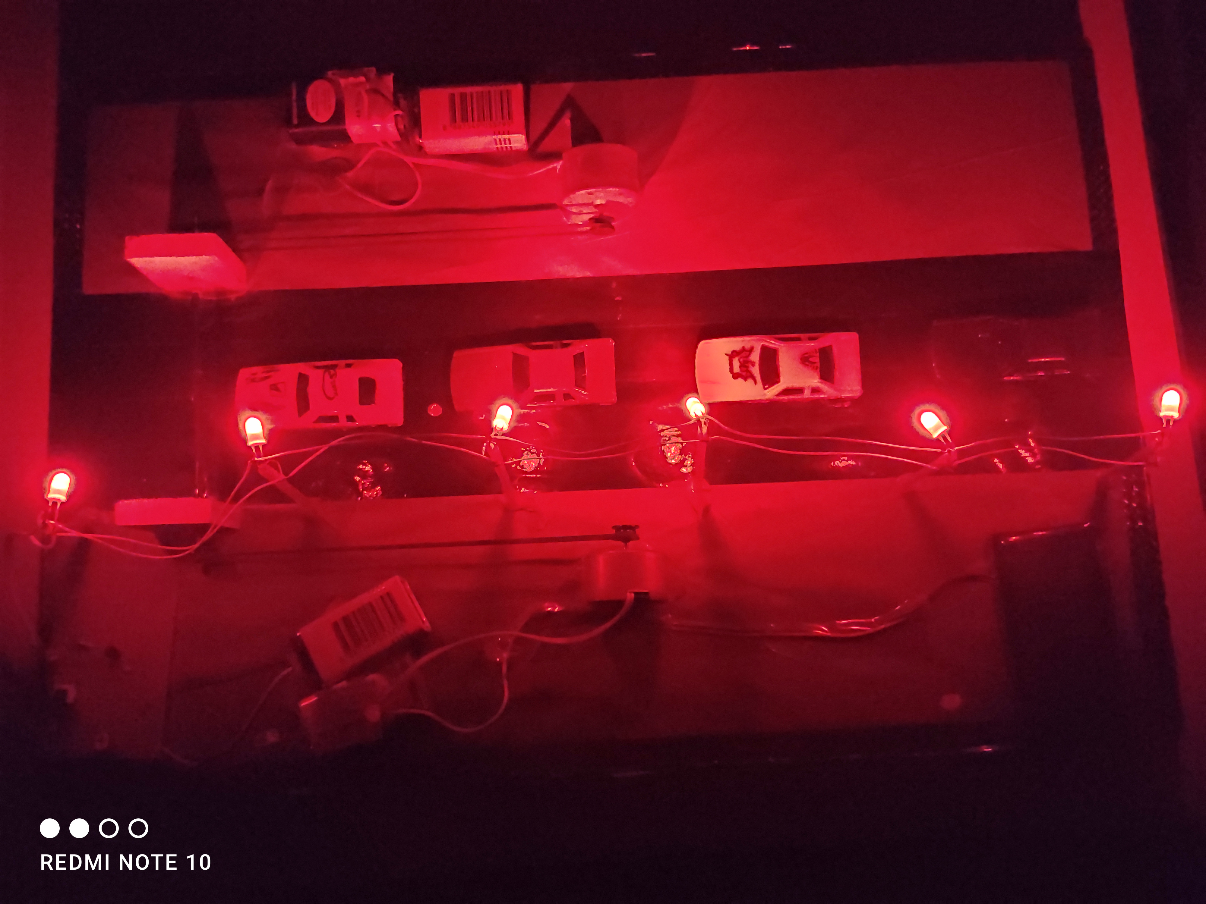

Slide 12
MATHEMATICAL CALCULATION
Voltage production from model: Voltage produced when 1 vehicle is passed from the speed breaker: 3V
Let us assume 1 vehicle is passed in 1 minute
Then number of vehicles passed in 1 hour: 60 Voltage
produce in 1 hour: 60*3=180V
Voltage produce in 24 hour: 180*24=4320V
So, it will produce 4KV voltage in 1 Day 240V voltage is sufficient for emitting 4 Bulb of 60W

Slide 13
CONCLUSION
For the improvement of living standard in day to day life we require electricity. This electricity is obtained from the primary sources like coal, gases, etc. but this source is going to be reduced due to increasing population. So this project helps to overcome this problem. This project represents the new technology to generate the electricity from speed breaker. This project not only provide alternative but also provide economy to the country

Slide 14
THANK YOU

